Slide 1



Server Arch. Scaling Issues
@gaar4ica
Anna Shcherbinina

Slide 2

I like Ruby & Arch
Notes:
My name is Anna. I like ruby, play with Crytsal. I write on C# from time to time and it drives me crazy to switch from OSX hot keys to Windows and back.
I like coding, architecture and delivering my products. In our team every back-ender is responsible for production infrastructure. You can say, it's bad. Sometimes i can agree, but in common it is so cool, when developer really thinks about how his feature will work in production, not only on the code level, but on ifrastructure level too.

Slide 3

a lot of stuff in Artec3D
Notes:
I work in Artec3D for 6 years. We make the best hand-held 3D scanners and software in the world. The company is head-quaterd in Luxembourg, with offices in California and moscow where i am based. I lead web development in Artec and we are developing web side 3d scanning services.
Back than 6 years ago our web development started from two developers and two projects, one hosted on Heroku and another on rented server somewhere in europe.
Our development team grew as grew number of projects. Now we have Back-enders, front-enders, qa-automators in our team. Autoscaling projects, monilithic projects, projects served by linux and windows. In ruby, C#, Node JS, React and so on.

Slide 4



Downtime?
Never heard of…
Notes:
Have you ever had downtime by your fault while your career?
You know what? I have failures all the time, Once I've lost production database while i was sure i had backups. I had not.
I had to roll-back my release when CI showed excellent results with 100 code coverage , because i had bugs. I failed under capacity several times. But that's ok.
When it happened i had amazing take out. I was able to look through my infrastructure and find rooms for improvement.

Slide 5

App structure
Typical components and processes in web service
Components:
Front servers
Back servers
Search engines
DB services
Caching services
Background tasks servers
Log services
Statistics services
Processes:
Front
Back office
Search
Pushes
Caching
Background tasks
Notes:
Для начала стоит определиться из чего же из чего же сделан типичный веб сервис.
Стоит учитывать как компоненты, так и процессы.
Компоненты определяют элемент, который предстоит вписать в систему. Компонент подвергается масштабированию
Фиксация процессов нужна чтобы видеть как компоненты воздействуют друг на друга. При проектировании масштабируемой системы анализируются в первую очередь.

Slide 6
Be ready for capacity
Notes:
Let's look at capacity.
I'm talking not only about high load applications. Capacity can catch your 10 users per day application. And of course it depends on your application type and infrastructure.
Let's figure out what is it monolithic application, what is micro service architecture. And how can we prepare for capacity?

Slide 7
Monolithic app
A monolithic application describes a single-tiered software application in which the user interface and data access code are combined into a single program from a single platform.
A monolithic application is self-contained, and independent from other computing applications.
Notes:
What do we know about monolithic applications?
Firstly it is something very bound and not easy to split. Therefore it is hard to scale. The most common way - is to buy bigger hardware. With greater CPU and memory and hard drive or SSD.
Unfortunately it is not the best way of scaling.

Slide 8
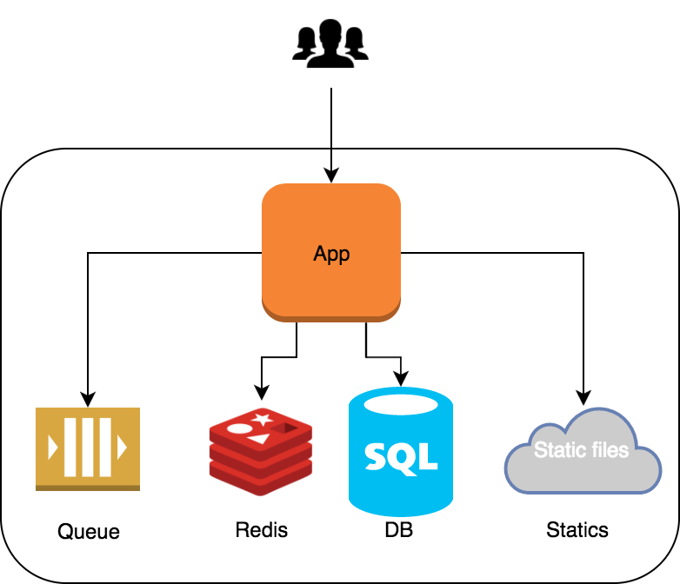
Monolithic app
Notes:
For example your app needs more file system space.
You can buy twice bigger server, but in addition you receive CPU or memory you don't need. Even if you buy exactly what you need you have no garantees that in a month you do not want something else.
Another example is your database requires more CPU and you've bought sever with better CPU. Occasionally your app started using this additional CPU instead of your database. Not cool

Slide 9
Microservices
Microservices - also known as the microservice architecture - is an architectural style that structures an application as a collection of loosely coupled services.
In a microservices architecture, services should be fine-grained and the protocols should be lightweight.
Notes:
What about micro services?
For example in service one, that serves your clients request requires some data from service two.
In this example we have multiplication response time from service 1 and service two. And even if you improve response time of one service it does not guarantee you that whole response time has improved.

Slide 10
Microservices
Notes:
In this perspective let's look at the bottle necks.
Under capacity your application becomes slow. You see the bottle neck, let's say it is your file system read / write indicators in service one. Ok, you're a cool developer and you know how to improve it. Done! You don't have problems with file system read / writes anymore.
You're happy because you're the good problem solver. But the next capacity will show you that your bottle neck moved to service two. Because service two was not ready for the throughput you achieved in service one. Sound dramatic, isn't it?

Slide 11
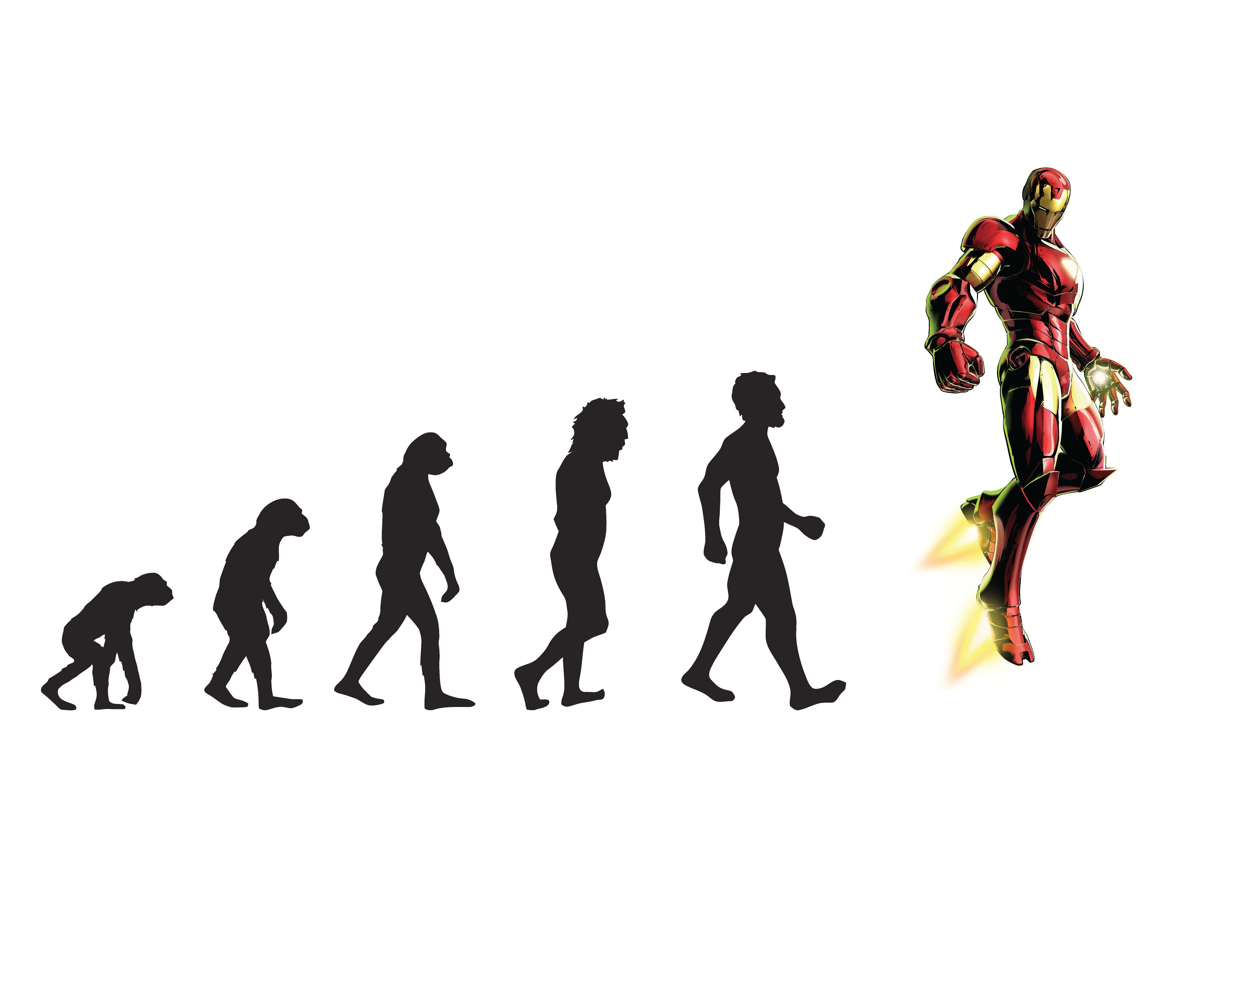
Scaling from old time to now-days
Notes:
It is often told that "scaling up is failing up."
What does that mean? it is critical for companies to plan to scale.
When hyper growth companies do not scale out, their only option is to buy bigger and faster systems
When they hit the limitation of the fastest and biggest system provided by the most costly provider, they are in big trouble.
Ultimately, this is what hurt eBay in 1999, and we still see it more than a decade later in many companies
So it is important to scale out not just UP

Slide 12
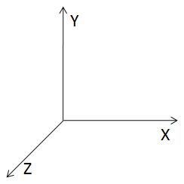
Axes of scale
Split by Function, Service or Resource
Horizontal duplication
Lookups or Formulaic Splits
Notes:
Let's go through the theoretical aspects of scaling.
We are going to discuss scaling databases and services through cloning and replication, separating functionality or services and splitting similar data sets across storage and systems.
We can simply visualise it with three directions. X is horizontal scaling, Y is splitting by services or resources and Z is sharding or podding, splitting similar data.

Slide 13
Axes of scale
Scale by cloning - Cloning or duplicating data and services allows us to scale transactions easily.
Scale by splitting different things - Use nouns or verbs to identify data and services to separate. If done properly, both transactions and data sets can be scaled efficiently.
Scale by splitting similar things - Typically these are customer data sets. Set customers up into unique and separated shards or swimlanes to enable transaction and data scaling.
Notes:
Scaling by cloning means that you can double throughput of your application simply by setting up another instance
Scaling by splitting different things means that you can divide part of your application and grant more resources to it.
Scaling by splitting similar things is when you split your data by any marker and scale parts separately.

Slide 14
X-axis
Clone things
What: Typically called horizontal scale, this is the duplication of services or databases to spread transaction load.
Why: Allows for fast scale of transactions at the cost of duplicated data and functionality.
Notes:
The first and easy way of scaling is horizontal.
All of you must have heard about it. It is often about duplication:
duplication database instances in master / slave mode,
duplication of front or back servers behind load balancers,
duplication of background workers.

Slide 15
X-axis
Clone things
When to use:
  Databases with a very high read to write ratio (3:1 or greater-the higher the better).
  Any system where transaction growth exceeds data growth.
How to use:
  Simply clone services and implement a load balancer.
  For databases, ensure the accessing code understands the difference between a read and a write.
Notes:
We use horisontal scaling when there is an ability to parallelise our work.
We still have one entry point, but:
we can set up load balancer
and increase instances are responsible for requests,
thereby increase our throughput.
Or set up Database in master / slave mode when read / write ratio is more than 3 up to 1.

Slide 16
X-axis
Clone things
Key takeaways:
fast to implement
can allow for transaction
but not data scalability
Notes:
By horisontal scale we can achieve better throughput score without increasing the characteristics of our hardware. Only by duplication.
Have you ever thought about the price of complexity?
About 15 years ago, all of us used USB flash cards
I could buy 1 gigabyte flash card for 10 dollars but when I wanted to buy 4gigabyte flash card it costed not 40 dollars but around a hundred?
At that time I couldn't just buy 256 gigabyte flash card even when i was ready pay a thousand dollars for it, because there was no such one. Because there was no such hardware invented to satisfy my needs.
So let's pay 40 dollars for 4 items of 1 gigabyte flash card instead of hundred for 1 4gigabyte and avoid issues with physical limitations.

Slide 17
Y-axis
Split different
What: Sometimes referred to as scale through services or resources, focuses on scaling data sets, transactions and engineering teams.
Why: Allows for efficient scaling of not only transactions, but very large data sets associated with those transactions.
Notes:
So-called micro services are the implementation of the main idea of Y-axis scaling.
We scale application by splitting processes and resources.
If our application split into microservices, we can focus on scaling only necessary parts of it.

Slide 18
Y-axis
Split different
When to use:
  Very large data sets where relations between data are not necessary.
  Large, complex systems where scaling engineering resources requires specialisation.
How to use:
  Split up actions by using verbs or resources by using nouns or use a mix.
  Split both the services and the data along the lines defined by verb/noun approach.
Notes:
If you see that part of your application is not connected much with other parts - split it.
For example image cropping, that requires CPU or analytics report processing that is always about hard queries to database.
The key feature is to learn how to split monolithic application.
Also here is a great benefit - when part of your functionality separated you can exchange one of your services to another. You can use another programming language, another tool and even operations system if it better fits the approach.

Slide 19
Y-axis
Split different
Key takeaways:
Efficient scaling of:
transactions,
large data sets,
Can help with fault isolation.
Notes:
The good example is background workers.
Let's assume you have several types of background tasks that requires different types of resources.
Let's say worker one requires twice more CPU, and worker two does not. If your background jobs split by its type you can save money by using twice more resources only for one type of your background jobs. And use light-weight cheap hardware for another one.

Slide 20
Z-axis
Split similar
What: This is very often a split by some unique aspect of the customer such as customer ID, name, geography and so on.
Why: Rapid customer growth exceeds other forms of data growth or you have the need to perform fault isolation between certain customer groups as you scale.
Notes:
The idea of splitting similar things is quite simple.
In some cases it is the best way to scale resources. For example you are responsible for a platform for online sales, and you have lots of small online shops among your clients.
But one of your clients has 1000 times more sales than others. It has a lot of goods and information. The best way in this situation is to separate him and his sales to a standalone hardware.

Slide 21
Z-axis
Split similar
When to use:
  Very large similar data sets such as large or rapidly growing customer bases.
How to use:
  Identify something you know about the customer, such as customer ID, last name, geography, or device and split or partition both data and services based on that attribute.
Notes:
Or another example - you have a news portal.
Response time for request is vital for your application when your users are all over the world.
It does not matter where you are going to locate your application, some of clients would not be happy enough.

Slide 22
Z-axis
Split similar
Notes:
In this example we see that our application split by similar thing.
News articles with its resources split by geolocation principles. When news subject is somewhere in Europe - we keep it in European data centre and when in US keep it in USA.
It does not mean that I can't open eu news from usa, it means that the most relevant news articles are located in the nearest data centre.

Slide 23
Z-axis
Split similar
Key takeaways:
Z-axis splits are effective at helping you to scale customer bases but can also be applied to other very large data sets that can’t be pulled apart using the Y axis methodology.
Notes:
Z axis scaling helps you to scale not just big database but grants you an ability to apply scaling out by X and Y axis to each parts of your database separately.

Slide 24
What prevents us from successful scaling?
Notes:
We walked though three theoretical approaches of scaling.
It sounds quite simple and easy-to-use. But scaling properly is still a big problem for many companies and development teams.
Well let's look at what prevents us from scaling

Slide 25
DB
Monolithic apps / microservices
X-axis scaling is not an option when your app’s database or database of your microservice is on the same server or container.
TODO: separate your database to its own server or container.
Benefits:
  X and Y scaling ability for your app;
  As well as X and Y scaling ability for your DB.
Notes:
Database is always an issue.
If you host your database and your application on the common hardware it means It won't be easy just to duplicate your application on another server. Because your applications replica also requires connection to your database.
Also if you still keep database and first instance of application on the common hardware, twice more connections to your database can take away resources from your first application instance and make it work worse.
That's why duplication can become not so helpful. Keep your database way from your app

Slide 26
Cache storage
Monolithic apps / microservices
X-axis scaling hard to maintain when your app uses cache on the same server or container.
TODO: separate your cache storage to its own server or container.
Benefits:
  X and Y scaling ability for your app;
  As well as X and Y scaling ability for your Cache storage.
Notes:
Same idea is relevant to cache storage.
It does not matter what do you use as a cache storage - keep it separately from your app.
Also we have lots of benefits in such separation. If cache storage or database requires more special resources you can add required one and be sure, that it is exactly cache storage use additional resources, not your app or whatever you can host on the common hardware.

Slide 27
Logs
Monolithic apps / microservices
X-axis scaling and analysing is hard when your app’s logs or logs of your microservice is on the same server or container (or even worse).
TODO: use single log storage on its own server, container or external service.
Benefits:
  X and Y axis scaling for your app;
  Easy to search and analyse logs.
Notes:
Separation of logs is also vital.
Let's assume you use horizontal scaling for your application.
But something went wrong.
How will you know what exactly is wrong?
On which instance?
Is there a problem in your code?
Or the problem is with hardware.
Maybe it is storage one of your servers?
To be able to solve these issues you should have one single log storage. Also it is helpful when your logs are not just a files in file system, but some more useful tool with
search
tags
and alerts.

Slide 28
FS
Monolithic apps / microservices
X-axis scaling is not an option when your app’s use file system for storage static content, cache storage, temporary results between background jobs. Ex images, videos, js, css etc.
TODO: separate your static content storage to its own server or container. Use CDN.
Benefits:
  X and Y axis scaling for your app;
  Access to static content faster via geolocation cache of CDN.
Notes:
As for static content - please tell me you've separated it from your application.
it can grab your file system space,
it can affect your application in a bad way.
There is no space left on device, quite familiar problem, isn't it?
It means
nobody of your clients can upload a single file,
you can't deploy,
sometimes you even can't just search something in your terminal in ssh session to find out who ate free space.
That's why i recommend to separate static content away from your app. Use CDN for static content to make access to you statics even faster via geolocation cache of CDN.

Slide 29
Stateless - is the common guide
Notes:
I think you've already understand. The key is stateless.
When your app do not have physical state between requests you can apply every direction of scale.

Slide 30
Stateless flow
Monolithic apps / microservices
Strive for stateless:
Between requests
Between request and background job
Between background jobs
Avoid collisions with horizontal scaling:
With background jobs;
With deployment.
Notes:
Strive for stateless
between requests,
background jobs
and both requests and background jobs.
It will help you to avoid collisions with horizontal scaling
when each of your background workers can perform special action.
And collisions with deployment, when your new revision of code does not know about previous interjacent state of task, request or both.

Slide 31
Stateless flow
X & Y axis
Notes:
Let's look at the scheme.
Here we have horizontal scaled application with instances behind load balancer.
Here is vertical scaling, where
push requests from sockets are served by it's own type of instances,
https requests are served by other ones,
and api requests are served by its own.
Also here we have different types of background workers.
By the way it is partial arch scheme of our comming soon application.

Slide 32
Components interaction

Slide 33
Interaction
SPoF
Single points of failure:
Try to avoid single points of failure;
Active - active configurations are more preferable than active - passive;
Check failure possibility for the component.

Slide 34
Interaction
Request queues
Request queues:
Avoid multiplication of requests;
Use async interaction as much as possible.

Slide 35
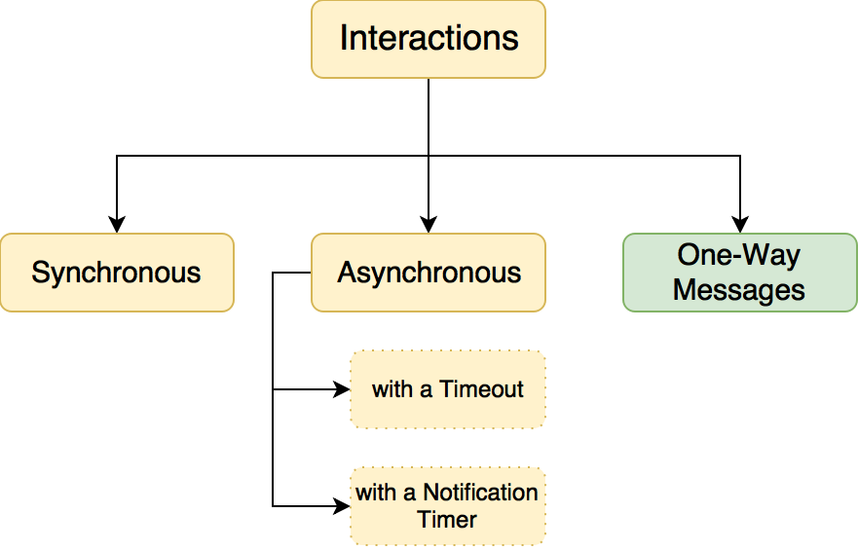
Interaction
Interaction patterns

Slide 36
Interaction
One-way messages
One-way messages use when we don’t really need the response:
  there is no heavy validations;
  “retries if failed” set up properly;
  when client can send request to server later.
Unobvious benefit - web app took several steps towards having offline mode.

Slide 37
Be ready for failure
Notes:
Failures happens from time to time. That's unavoidable part of our life.
But consequences can be different. If you are ready for failure
your clients,
even you boss
or teammates may not know that something was wrong and fixed.

Slide 38
Failure
Monitoring
Monitoring:
All server event logs;
Monitoring for proper updates;
Backup status;
Firewall activity, hack/spam relay attempts;
System bottlenecks (system processes, processor/ram utilization, etc.);
Application services;
Real-time Inventory collection and web-based reporting;
Remote support for most issues.
Notes:
Imagine
your client experiences troubles with your app,
he asks support team for help.
Support team tells business owner about the trouble.
Business owner calls your boss
or the boss of your boss
and you are drinking 3rd beer after a hard and productive day by that time.
Sounds sad, isn't it?
Use monitoring tools and alert systems to avoid this case.
If you don't read emails during the day you should not set up monitoring to send you emails, set up alerts through messengers or even calls.
You know what? My car calls me every time when kick sensor triggers and it is amazing.
You must be the first person who knows that something wrong is going on.

Slide 39
Failure
Learn from failure
Take every opportunity to learn;
Leverage every failure to learn and teach important lessons;
Not only to solve, but prevent failures.
Notes:
Never waste an opportunity to learn from your failure.
It is important takeout that helps you to
avoid similar mistakes
and prevent new ones.
Of course when the problem is solved you feel satisfied. The problem is solved. But the main idea not only to solve, but prevent failures.

Slide 40
Failure
QA
QA does not increase quality of your system;
QA decrease risks;
Use QA team to learn from past mistakes;
QA helps to decrease a number of repeated defects.
Notes:
QA does not increase quality. QA is to minimise risks. It is you who can increase quality of your application.

Slide 41

Failure
Backups
Check your backups twice;
Store your backups away of your application;
Create backup for your backup.
Notes:
Who have ever lost production database at least once? Oh really
I did
Check your backups.
Go and check your backups twice.
Check the backup of your backup.
Even if it is not your responsibility,
especially when it is part of your duties.
Check your backups.
How many times I've heard stories, that finished somewhere on "Oh, well thats not a problem, i have a backup. Oh wait, where is it"

Slide 42
Failure
Deployment
Set up your deployment process to be ready for rollback;
Avoid irreversible releases;
Monitoring and metrics helps to measure and analyse result of the release;
Set up partial deployment.
Notes:
Be ready to rollback your release. You can find out that something bad is going on on your production servers.
It can be new feature with edge cases,
it can be old feature with new bugs.
It can be cool feature your bosses want to look in different way.
You should be the first person who knows what's going on with you project. Big smarty-pants companies use partial deploys. When new release delivers to 10 percent of users / services / resources. That's usually enough to check wether release is good. And if three are some troubles you can rollback easily.

Slide 43
Autoscaling
Notes:
Autoscaling
saves your money
and gives you confidence in your production stability.
If your application autoscaling is set up properly you are ready for high load. You can just miss that high load was, because everything works fine as expected

Slide 44
Autoscaling
Monitoring
Monitoring is the key feature of autoscaling;
Metrics should be re-estimated once a quoter;
Use complex metrics to avoid wasting resources.
Notes:
Of course you know that no metrics means no autoscaling.
You can scale only if you know for sure
when it is right time to increase your instances count
or when you don't need them anymore.
You can measure queue length for autoscaling background workers,
you can measure requests per second on your load balancer.
You can measure CPU or memory utilisation on your instances.

Slide 45
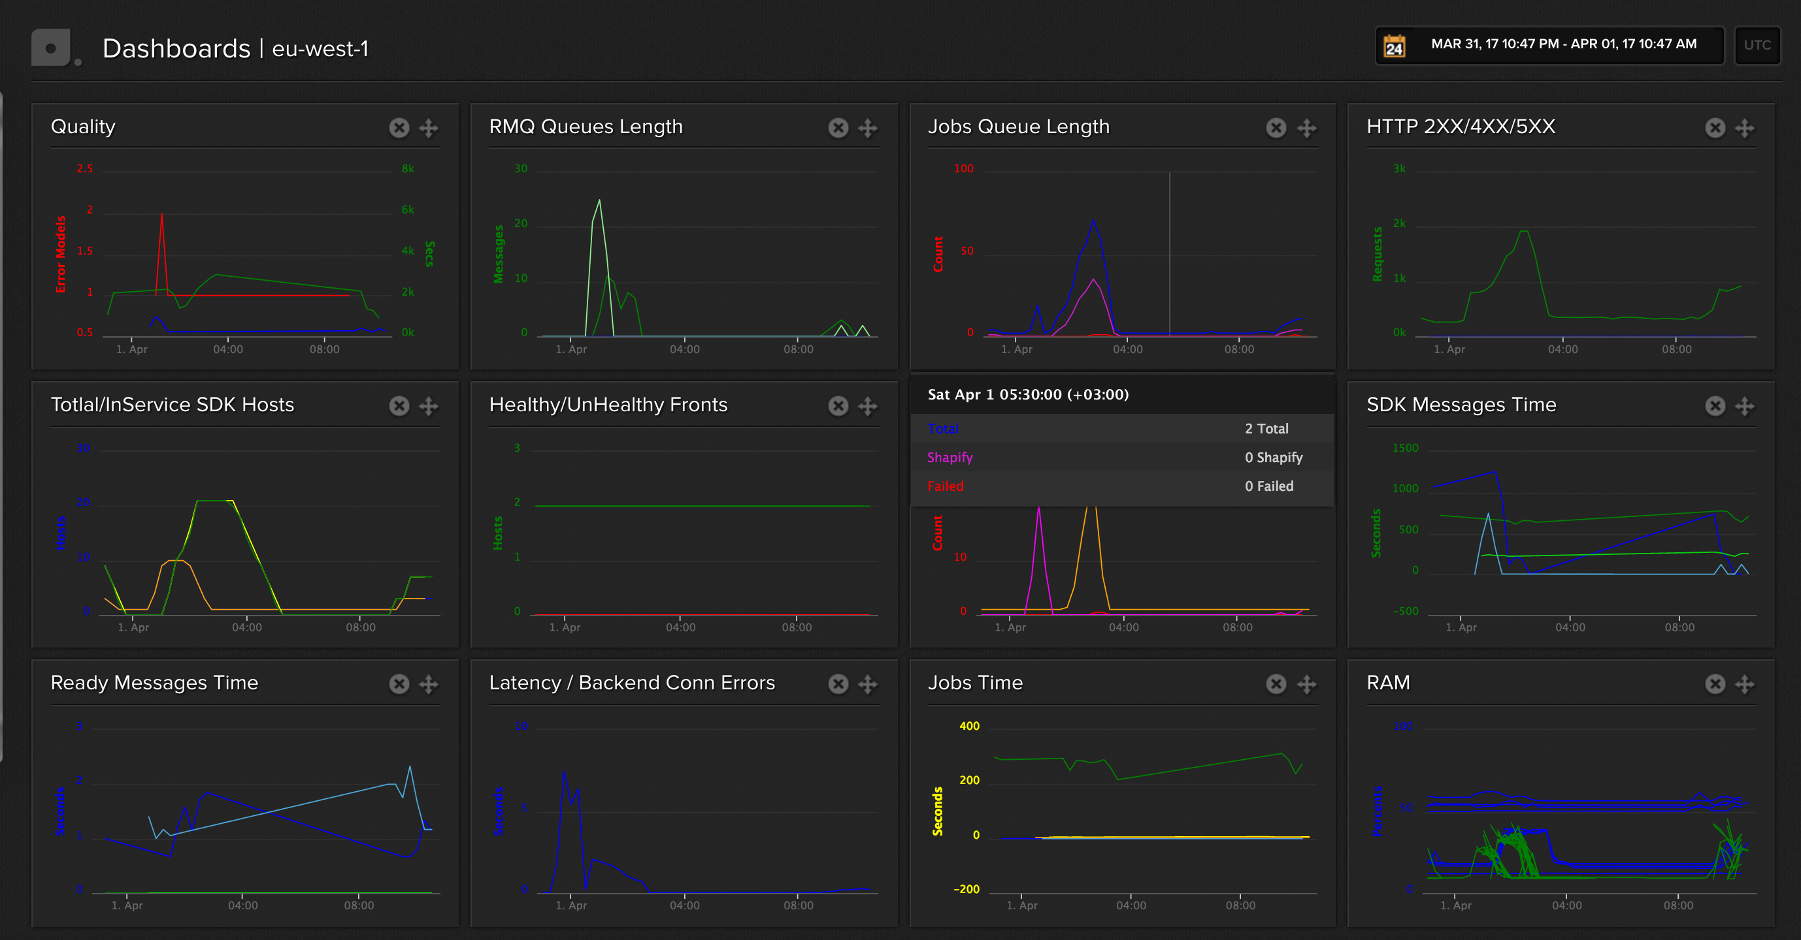
Autoscaling
Dashboard example
Notes:
It is vital not only to collect metrics but to turn it into monitoring system and dashboards. Dashboards allows you quickly to figure out what's going on right now or what was with your system 2 days ago.
One metric is usually not enough to scale properly. For example your new release starts using CPU 3 times more than usually. So your autoscaling service starts increasing instances without real reason. To avoid money loss use complex metrics
Look at the picture, it's my production dashboard, and i see that yesterday, to be correct today night during USA working day there was an exhibition with lots of scanning. I see it right in my dashboard.
Also it is good habit to re-estimate your metrics. As application grows up and your code changes you should change your infrastructure as well. Because your metrics can be not relevant anymore

Slide 46
Autoscaling
Scale down
Top and bottom limits are vital to avoid money loss;
Do not forget to empty resources your app does not need anymore.
Notes:
Properly scaled application empties resources when does not need them. It is always a compromise between
money saving
and time for delivery.

Slide 47
Autoscaling
Scale down
Notes:
Let's look at the example. It is relevant illustration of compromise, you're always face.
Let's assume we have 10 task to perform.
Each task performs about 10 minutes.
You perform one task on one instance in each moment
and you pay for you instances hourly.
For easy calculations lt costs 1 dollar per instance per hour. Well, what do we have?
Firstly and most aggressve - we can scale up 10 instances, perform all the tasks in 10 minutes and spend 10 dollars.
The most stupid option is to start one instance, perform all tasks in a hour and 40 minutes and spend 2 dollars.
The cheapest option is to scale up 2 instances and perform all the tasks in 50 minutes, spending two dollars.
Medium option is to scale up 3 or 4 instances and perform all tasks by 20-30 minutes, spending 3 or 4 dollars.
See, this is compromise between delivery time and cost.

Slide 48
About Datacenters

Slide 49
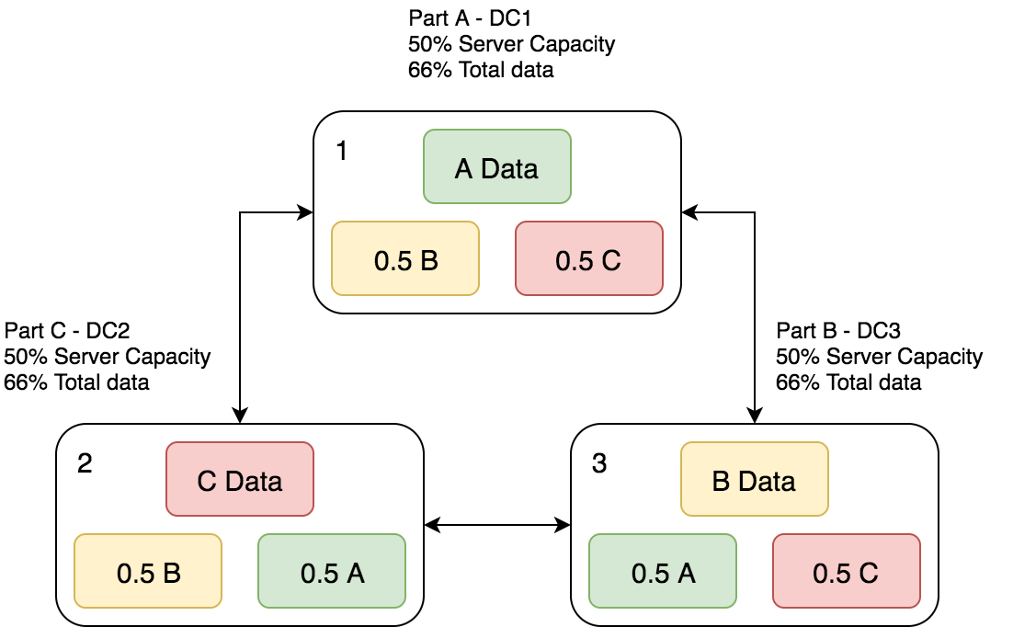
Datacenters
Scaling scheme

Slide 50
Datacenters
Scaling scheme
Using 3 Datacenters is most cost-effective option
Site configuration | Network | Servers | Databases | Storage | Network connectinos | Total cost
Single | 100% | 100% | 100% | 100% | 0 | 100%
2 DC Hot and Cold | 200% | 200% | 200% | 200% | 1 | 200%
2 DC Live / Live | 200% | 200% | 200% | 200% | 1 | 200%
3 DC Live / Live / Live | 150% | 150% | 150% | 200% | 3 | ~166%

Slide 51
Be competent
Notes:
In the end i want to wish you to be competent.
Learn every time,
learn every lesson.
Let your failures to teach you.
Use best practices
Read as much as you can.
Criticise the ideas.
Think about solutions
and be happy.

Slide 52

Thank you
https://twitter.com/gaar4ica
https://github.com/gaar4ica
Scalability Rules: 50 Principles for Scaling Web Sites (Martin L. Abbott, Michael T. Fisher)
Practical Object-Oriented Design in Ruby (Sandi Metz)
Eloquent Ruby (Russ Olsen)
Ruby Performance Optimization: Why Ruby is Slow, and How to Fix It (Alexander Dymo)
Design Patterns in Ruby (Russ Olsen)
Docker: Up & Running: Shipping Reliable Containers in Production (Karl Matthias)

